Slide 1
Training of Trainers for A/H1N1 Vaccine Deployment in Cambodia
Kampong Channang, 22-23 February 2010
Kampong Cham, 25-26 February 2010
with support from:
USAID thru AED and JSI DELIVER (thru PATH Cambodia) & WHO

Slide 2
Venue of training
Provincial Health Department of Kampong Chhnang, 22-23 Feb 2010
Kampong Chhnang is 90 kms away from central part of Phnom Penh.
The fourth province detected with high cases of H1H1 in 2009.
Strategic to gather representatives from 10 provinces for the first batch of TOT.

Slide 3
Venue of training
7Makara Hotel, Kampong Cham, 25-26 Feb.
Kampong Cham is 120 kms away from Phnom Penh.
The biggest province with a population of 1.5 million.
With reported cases of H1N1, but lower incidence than Kampong Chhnang.
Provincial health department hosted the training of 14 provinces

Slide 4
Participants
In Kampong Chhnang, representatives were from 10 provinces, namely: Takeo, Kampot, Pursat,Kokong,Kampong Speu, Svay Reing, Kampong Cham, Kep, Sihanoukville, and Bantay Meancheay.
In Kampong Cham, participants were from the remaining 14 provinces.
Participants are provincial health department directors or deputies, EPI chiefs and continuing education officers.

Slide 5
Expectations after TOT
In total, 24 provinces were represented in the TOT
Only participants from 4 priority provinces such as: Phnom Penh, Kandal, Kampong Chhnang, and Kampong Speu will cascade trainings of health care workers and vaccinators at operational districts of their provinces.
Those from 20 provinces are expected to prepare their operational plans while waiting for the next shipment of vaccine.

Slide 6
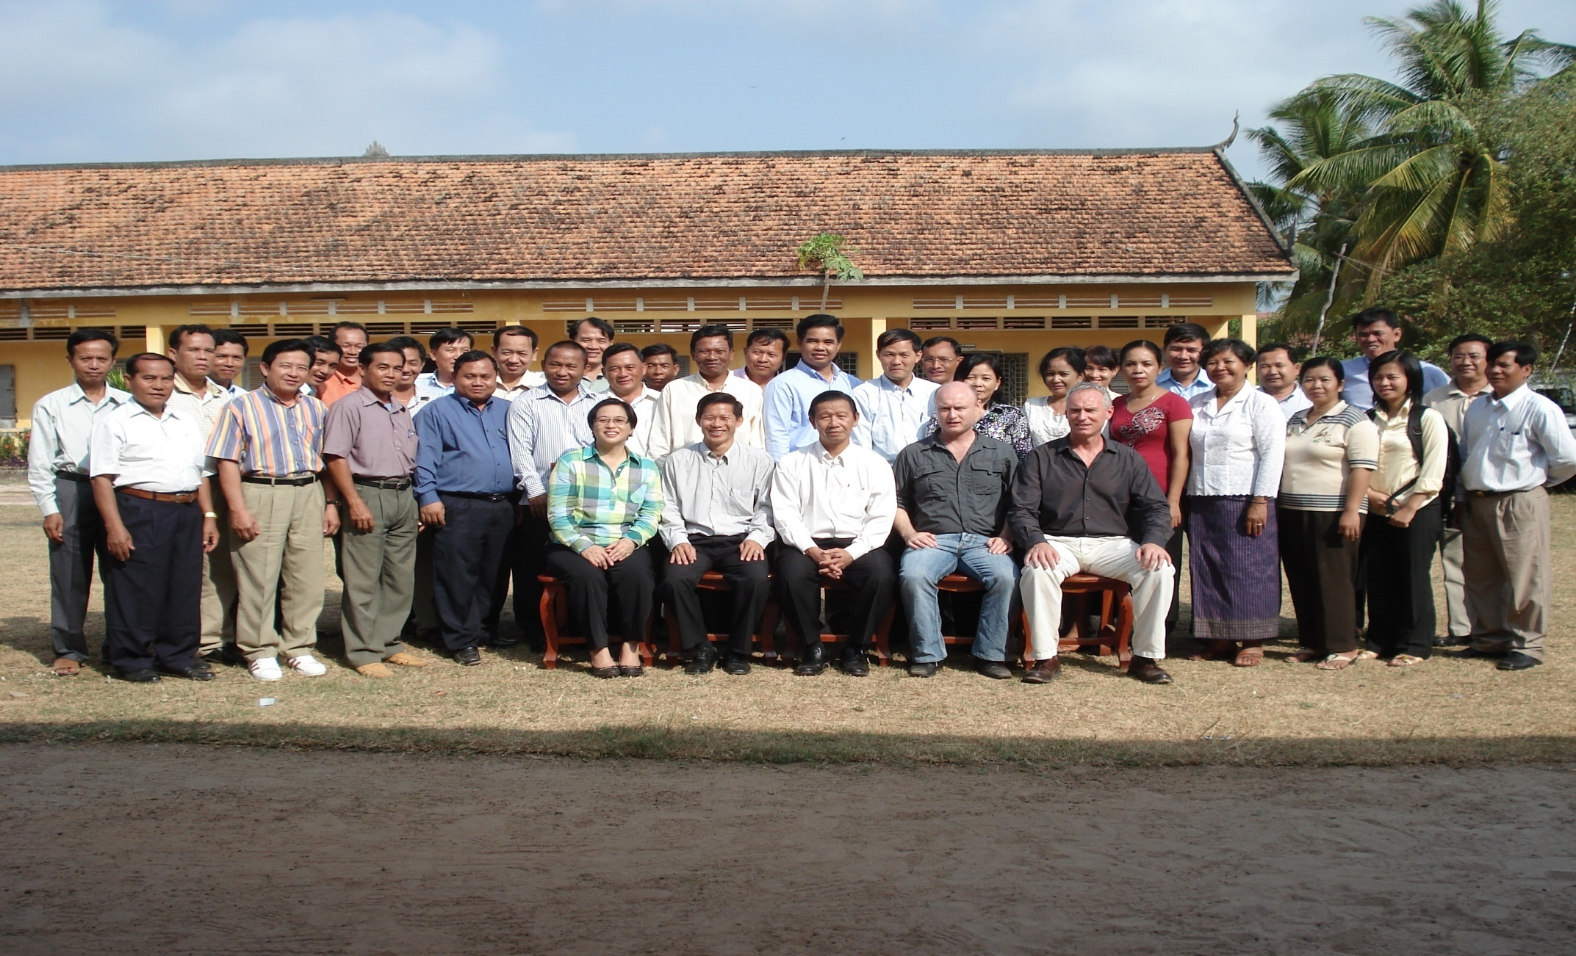
Group photo – Kampong Chhnang

Slide 7
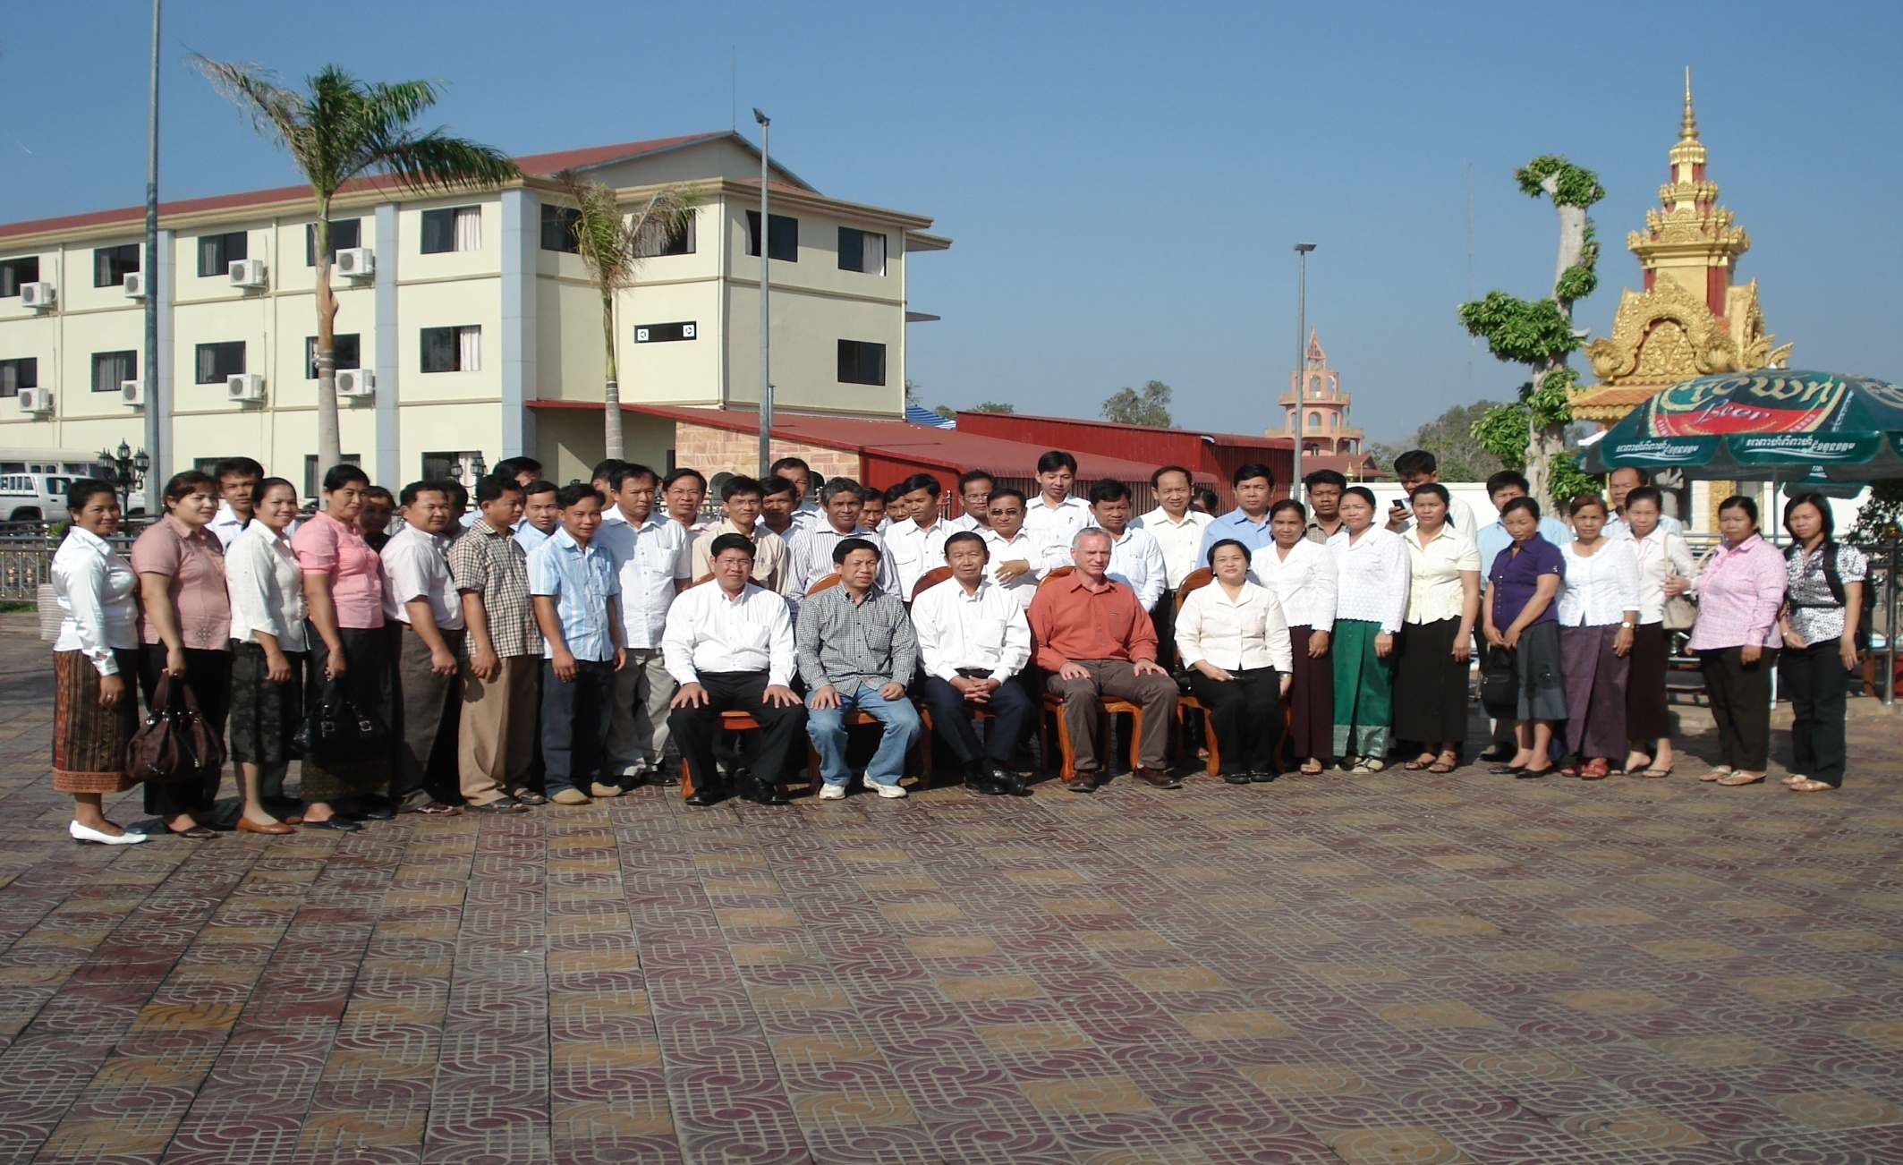
Group photo – Kampong Cham

Slide 8
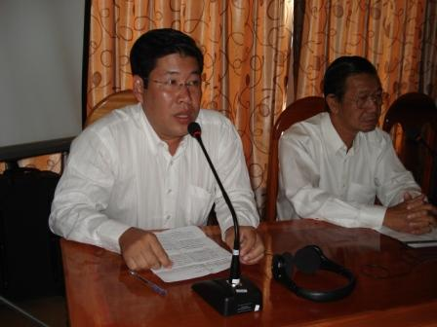
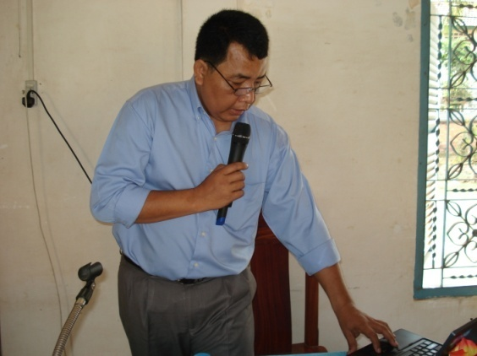
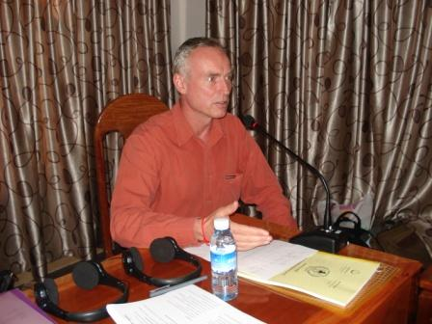
Opening
Welcome by Dep. Dir Dr Savuth
Emcee: Mr Ork Vichit, NIP
Message from WHO
Message by Prof. Sann Chan Seoung, NIP manager

Slide 9
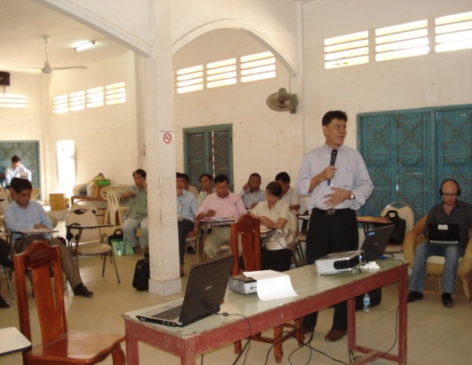
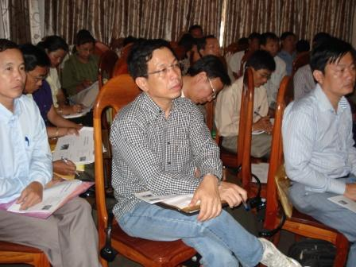
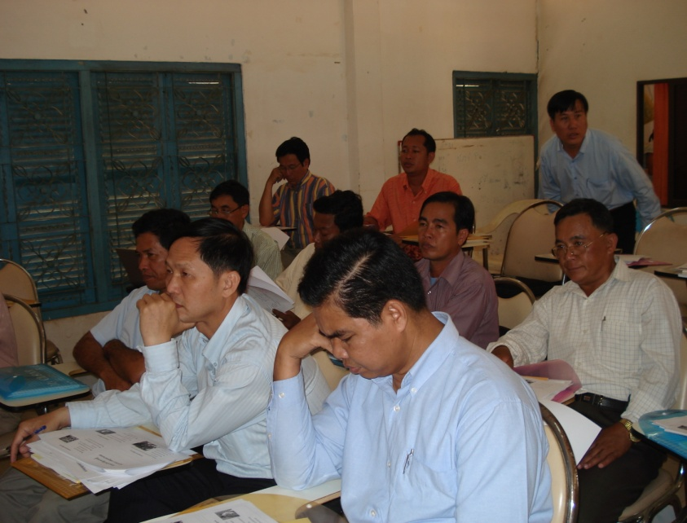
H1N1 background
Dr Chneng Mom of NIP PHN office provided basic information about H1N1.
What is H1N1? How does H1N1 transmitted? What is the H1N1 situation in Cambodia?
What are the symptoms? How do we protect ourselves and our families?

Slide 10
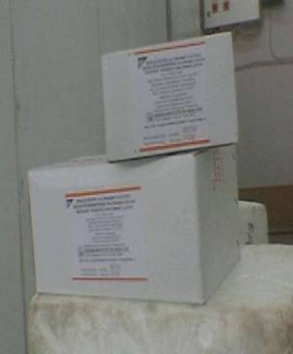
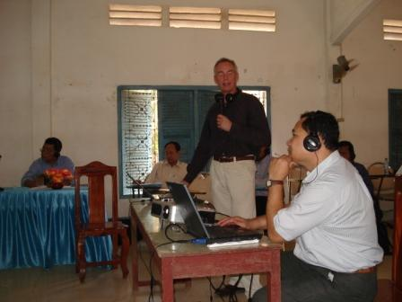
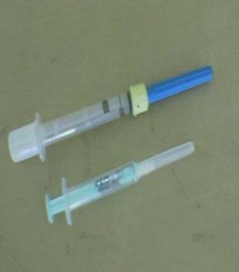
Logistic management
Peter Vanquaille, WHO consultant discussed logistic management.

Slide 11
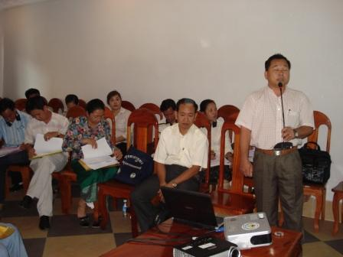
Defining roles and responsibilities
Mr Thom, NIP outlined the roles and responsibilities of vaccinators and village health support group.

Slide 12
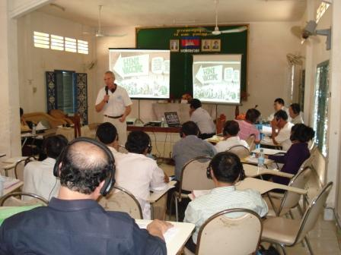
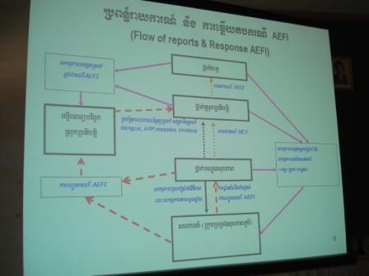
Vaccine management and adverse effect following immunization
Addressing AEFI... (what if? ) facilitated by Peter.

Slide 13
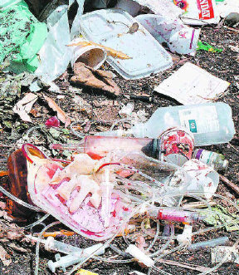
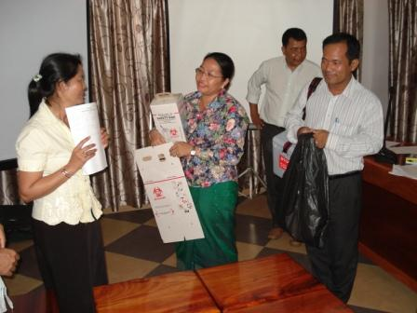
Waste management
A discussion of waste disposal plan and required guidelines.

Slide 14
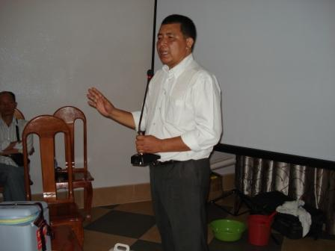
Termination of deployment
“All access vaccines and ancillaries left over from the campaign at any fixed site must be recorded and returned to provincial storage at the end of the campaign.”

Slide 15
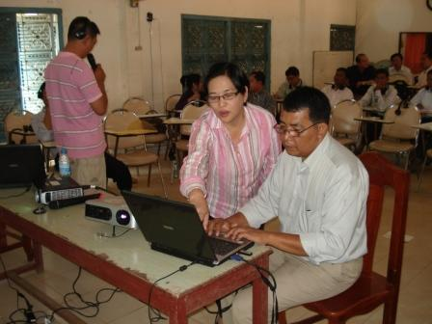
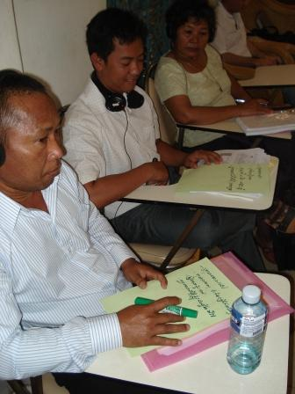
Communication
Identifying their target groups...

Slide 16
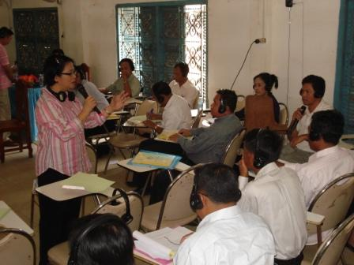
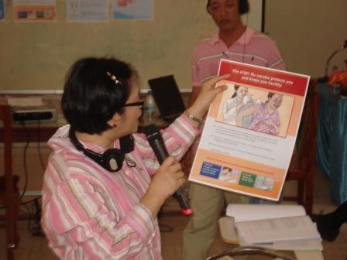
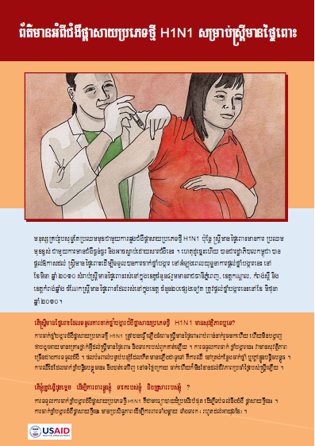
Communication
Providing the message for pregnant mothers...

Slide 17
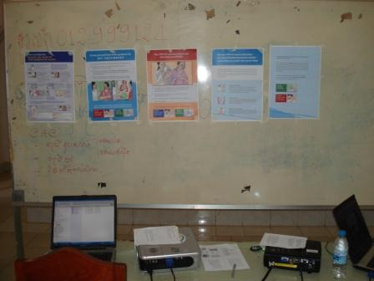
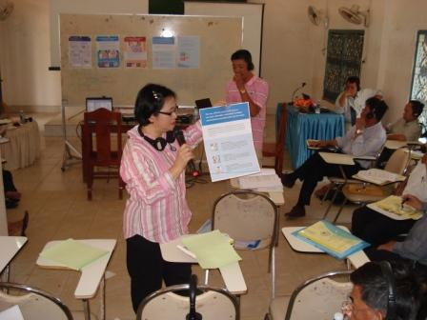
Communication
The job aids for health care workers

Slide 18
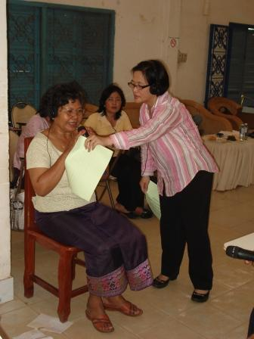
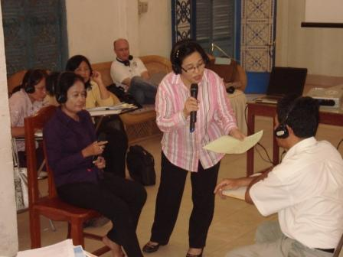
Working on scenarios
A male health care worker talking to the woman who shares a story of a pregnant woman who had miscarriage after receiving the vaccine (AFEI case).
A pregnant woman interested to get the vaccine but not so sure about its safety.

Slide 19
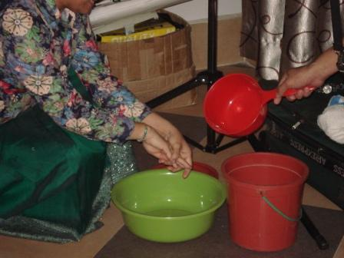
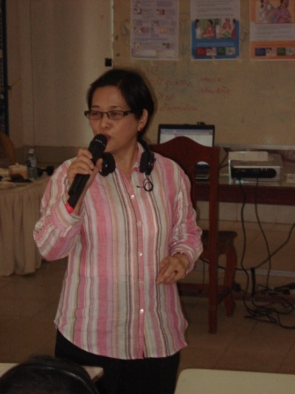
Reiterating H1N1 pandemic flu messages
Hand washing

Slide 20
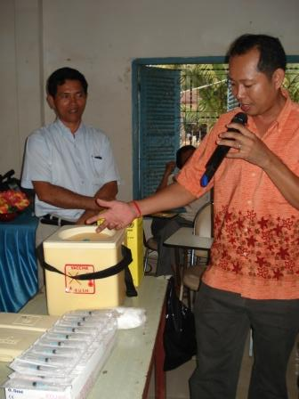
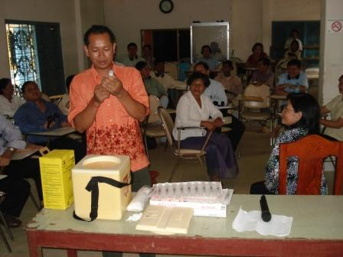
Role Play
Establishing a vaccination point
Preparation of the vaccination table

Slide 21
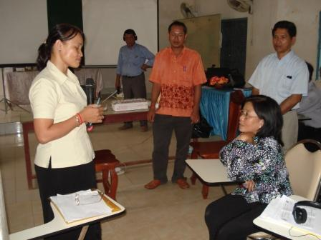
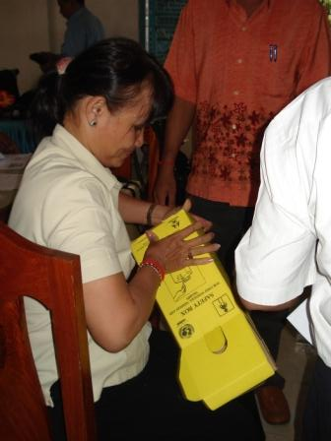
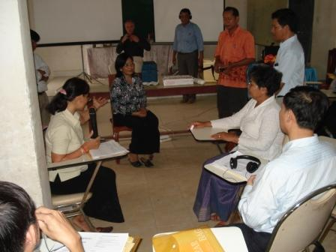
Role play
Assembly of the safety box
Counseling eligible clients...
Informing noneligible clients...

Slide 22
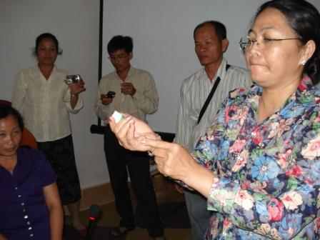
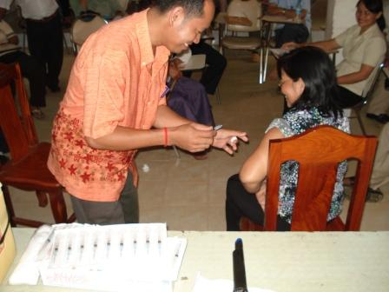
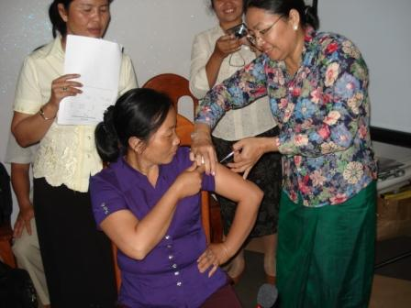
Role play
Vaccination

Slide 23
Lessons Learned
Coordination of technical assistance is difficult in a country where AED does not have physical presence.
Language barrier is a problem encountered both in technical and administrative process.
The communication module prepared by AED could have been maximally used if AED has been involved in the pre-planning stage and if a more organized (or proactive) assessment of the local partners was done.
IPC- related scenarios and role plays are found practical and more appreciated by participants if integrated with other technical sessions of the training.

